Slide 1


Think unlimited
SQL CASE STUDY
This presentation will introduce our Case Study project, highlighting its objectives, methodologies, and potential impact.
Danny Dinner

Slide 2



think unlimited
Project Overview
Danny seriously loves Japanese food so in the beginning of 2021, he decides to embark upon a risky venture and opens up a cute little restaurant that sells his 3 favourite foods: sushi, curry and ramen.
Danny’s Diner is in need of your assistance to help the restaurant stay afloat - the restaurant has captured some very basic data from their few months of operation but have no idea how to use their data to help them run the business.

Slide 3

Problem Statement
Danny wants to use the data to answer a few simple questions about his customers, especially about their visiting patterns, how much money they’ve spent and also which menu items are their favourite. Having this deeper connection with his customers will help him deliver a better and more personalised experience for his loyal customers. He plans on using these insights to help him decide whether he should expand the existing customer loyalty program.

Slide 4



Methodology
Data Collection
Analysis
Gather relevant data from diverse sources.
Solve Case Study .

Slide 5

Data Collection and Preprocessing
We gather relevant datasets from various sources and preprocess the data to ensure its quality and consistency.
Three key datasets for this case study
sales: The sales table captures all customer_id level purchases with an corresponding order_date and product_id information for when and what menu items were ordered.
menu: The menu table maps the product_id to the actual product_name and price of each menu item.
members: The members table captures the join_date when a customer_id joined the beta version of the Danny’s Diner loyalty program.

Slide 6
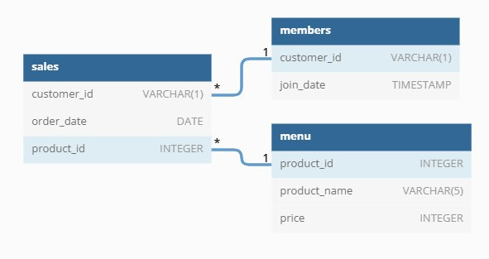
Entity Relationship Diagram

Slide 7


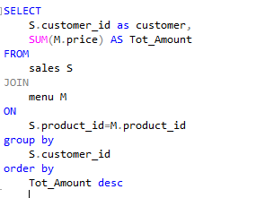
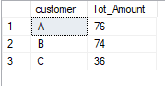
-What is the total amount each customer spent at the restaurant?

Slide 8
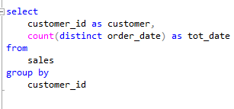
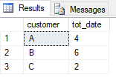
--How many days has each customer visited the restaurant?

Slide 9
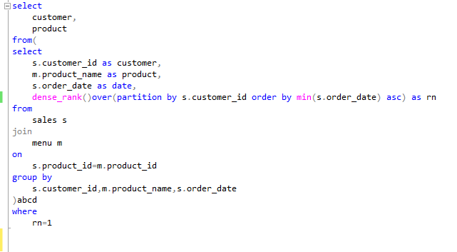
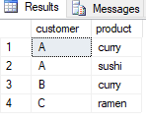
--What was the first item from the menu purchased by each customer?

Slide 10
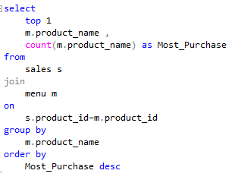
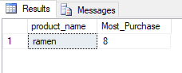
--What is the most purchased item on the menu and how many times was it purchased by all customers?

Slide 11
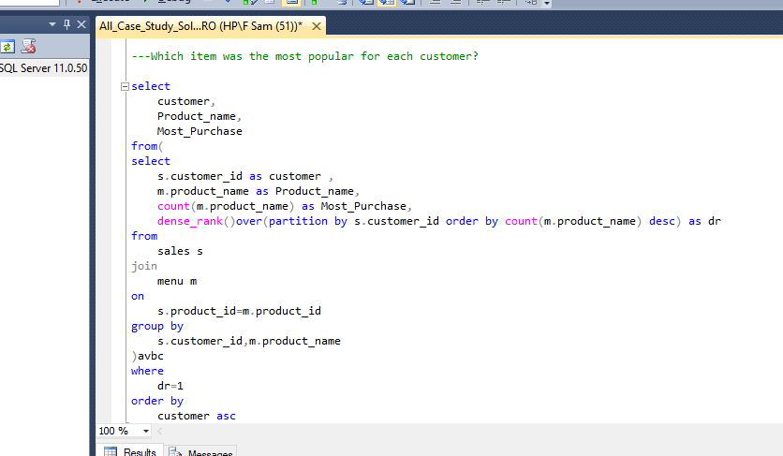
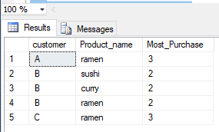
---Which item was the most popular for each customer?

Slide 12
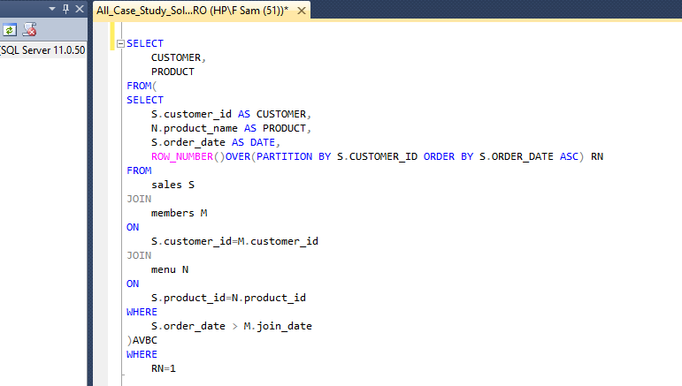
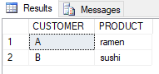
.Which item was purchased first by the customer after they became a member?

Slide 13
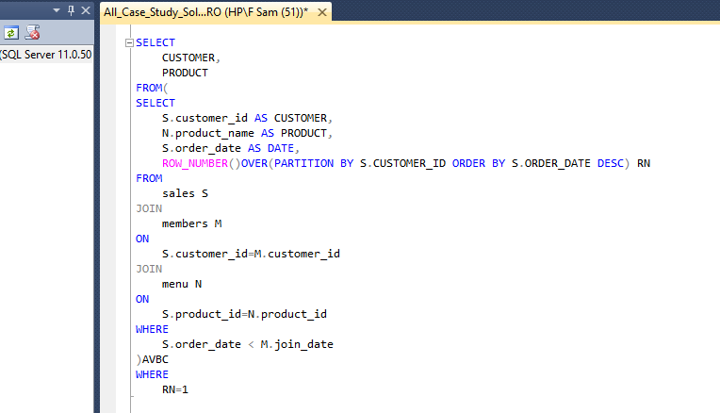
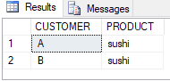
.Which item was purchased just before the customer became a member?

Slide 14
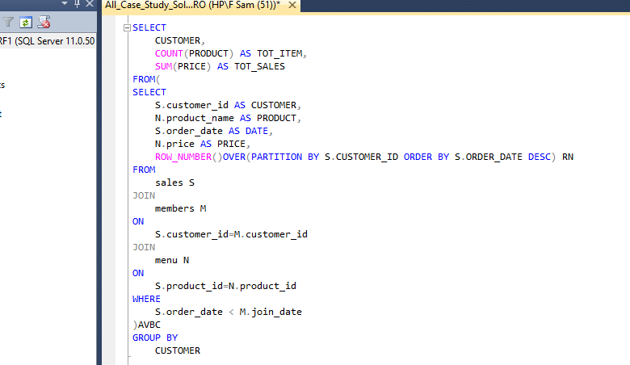
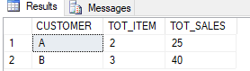
What is the total items and amount spent for each member before they became a member?

Slide 15
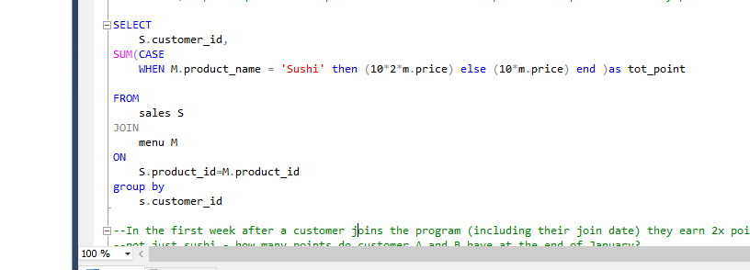
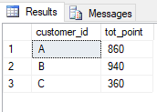
If each $1 spent equates to 10 points and sushi has a 2x points multiplier - how many points would each customer have?

Slide 16
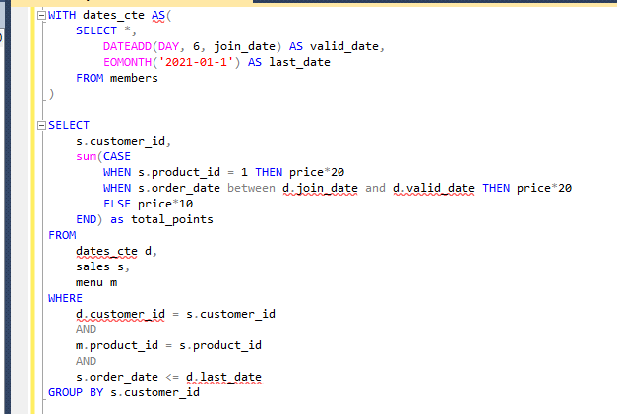
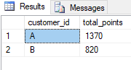
--In the first week after a customer joins the program (including their join date) they earn 2x points on all items, not just sushi - how many points do customer A and B have at the end of January?

Slide 17



think unlimited
Thank You!
Get in touch with us

